Slide 1
Understanding neuromuscular activity during swallows and rehabilitative maneuvers in patients with Parkinson’s disease: A preliminary study
Mentor: Dr. Malandraki
Macy Griffis

Slide 2
General information
Offshoot project from a larger NIH-funded study (PI: Dr. Malandraki).
Timeline for project
Data collection – Spring 2024 (done)
Project proposal – late Spring 2024/early Summer 2024 (done)
Data analysis – Summer 2024 (done)
Statistical Analysis – Fall 2024
Project presentation – late Fall 2024/early Spring 2025

Slide 3
Background & SIGNIFICANCE
Rehabilitative swallow maneuvers, such as the Mendelsohn maneuver and effortful swallow are the most often used swallowing exercises for dysphagia rehabilitation
Research to date has shown that each of these may improve certain aspects of swallowing physiology, such as laryngeal vestibule closure, hyoid excursion, pharyngeal constriction, and the overall pharyngeal swallow function (Doeltgen, Ong, Scholten, Cock, & Omari, 2017; Molfenter, Hsu, Lu, & Lazarus, 2018; Namiki et al., 2019)
However, the underlying neuromuscular mechanisms required for these maneuvers remain unclear and would be important to delineate for proper treatment planning.

Slide 4
Purpose of the study
To examine the comparative neuromuscular contribution of submental (under the chin) muscles during two commonly used swallow rehabilitative maneuvers and typical swallows in patients with idiopathic Parkinson’s disease.

Slide 5
Research Questions/aims
Aim 1: To identify and describe neuromuscular amplitude and timing components of typical swallows in patients with idiopathic Parkinson’s disease. The specific outcome measures that will be collected include burst duration of sEMG activity, normalized mean amplitude, and time-to-peak amplitude (TTP) during swallows.
Aim 2: To compare neuromuscular amplitude and timing components of rehabilitative swallowing maneuvers (effortful swallow, Mendelsohn maneuver) with typical swallows (5mL thin liquid and 5cc pudding) in patients with idiopathic PD.
Based on our prior work in healthy older adults (Peng et al., 2024), we hypothesize that in this group of patients, normalized amplitude will be higher during the effortful swallow and Mendelsohn maneuver as compared to typical swallows, with the effortful swallow eliciting the highest normalized amplitude.
Additionally, we hypothesize that typical swallows will possess shorter (faster) TTP measures when compared to both the effortful swallow and Mendelsohn maneuver, as also evidenced by prior work in healthy older adults (Peng et al., 2024).
Finally, we hypothesize that both the Mendelsohn maneuver and effortful swallow will show longer burst duration measures when compared to typical swallows, with the Mendelsohn maneuver possessing the longest due to our knowledge on how this maneuver is performed: by contracting the submental muscles for a longer duration.

Slide 6
METHODS - Participants
Cross-sectional prospective study
n= 15 (final)

Slide 7
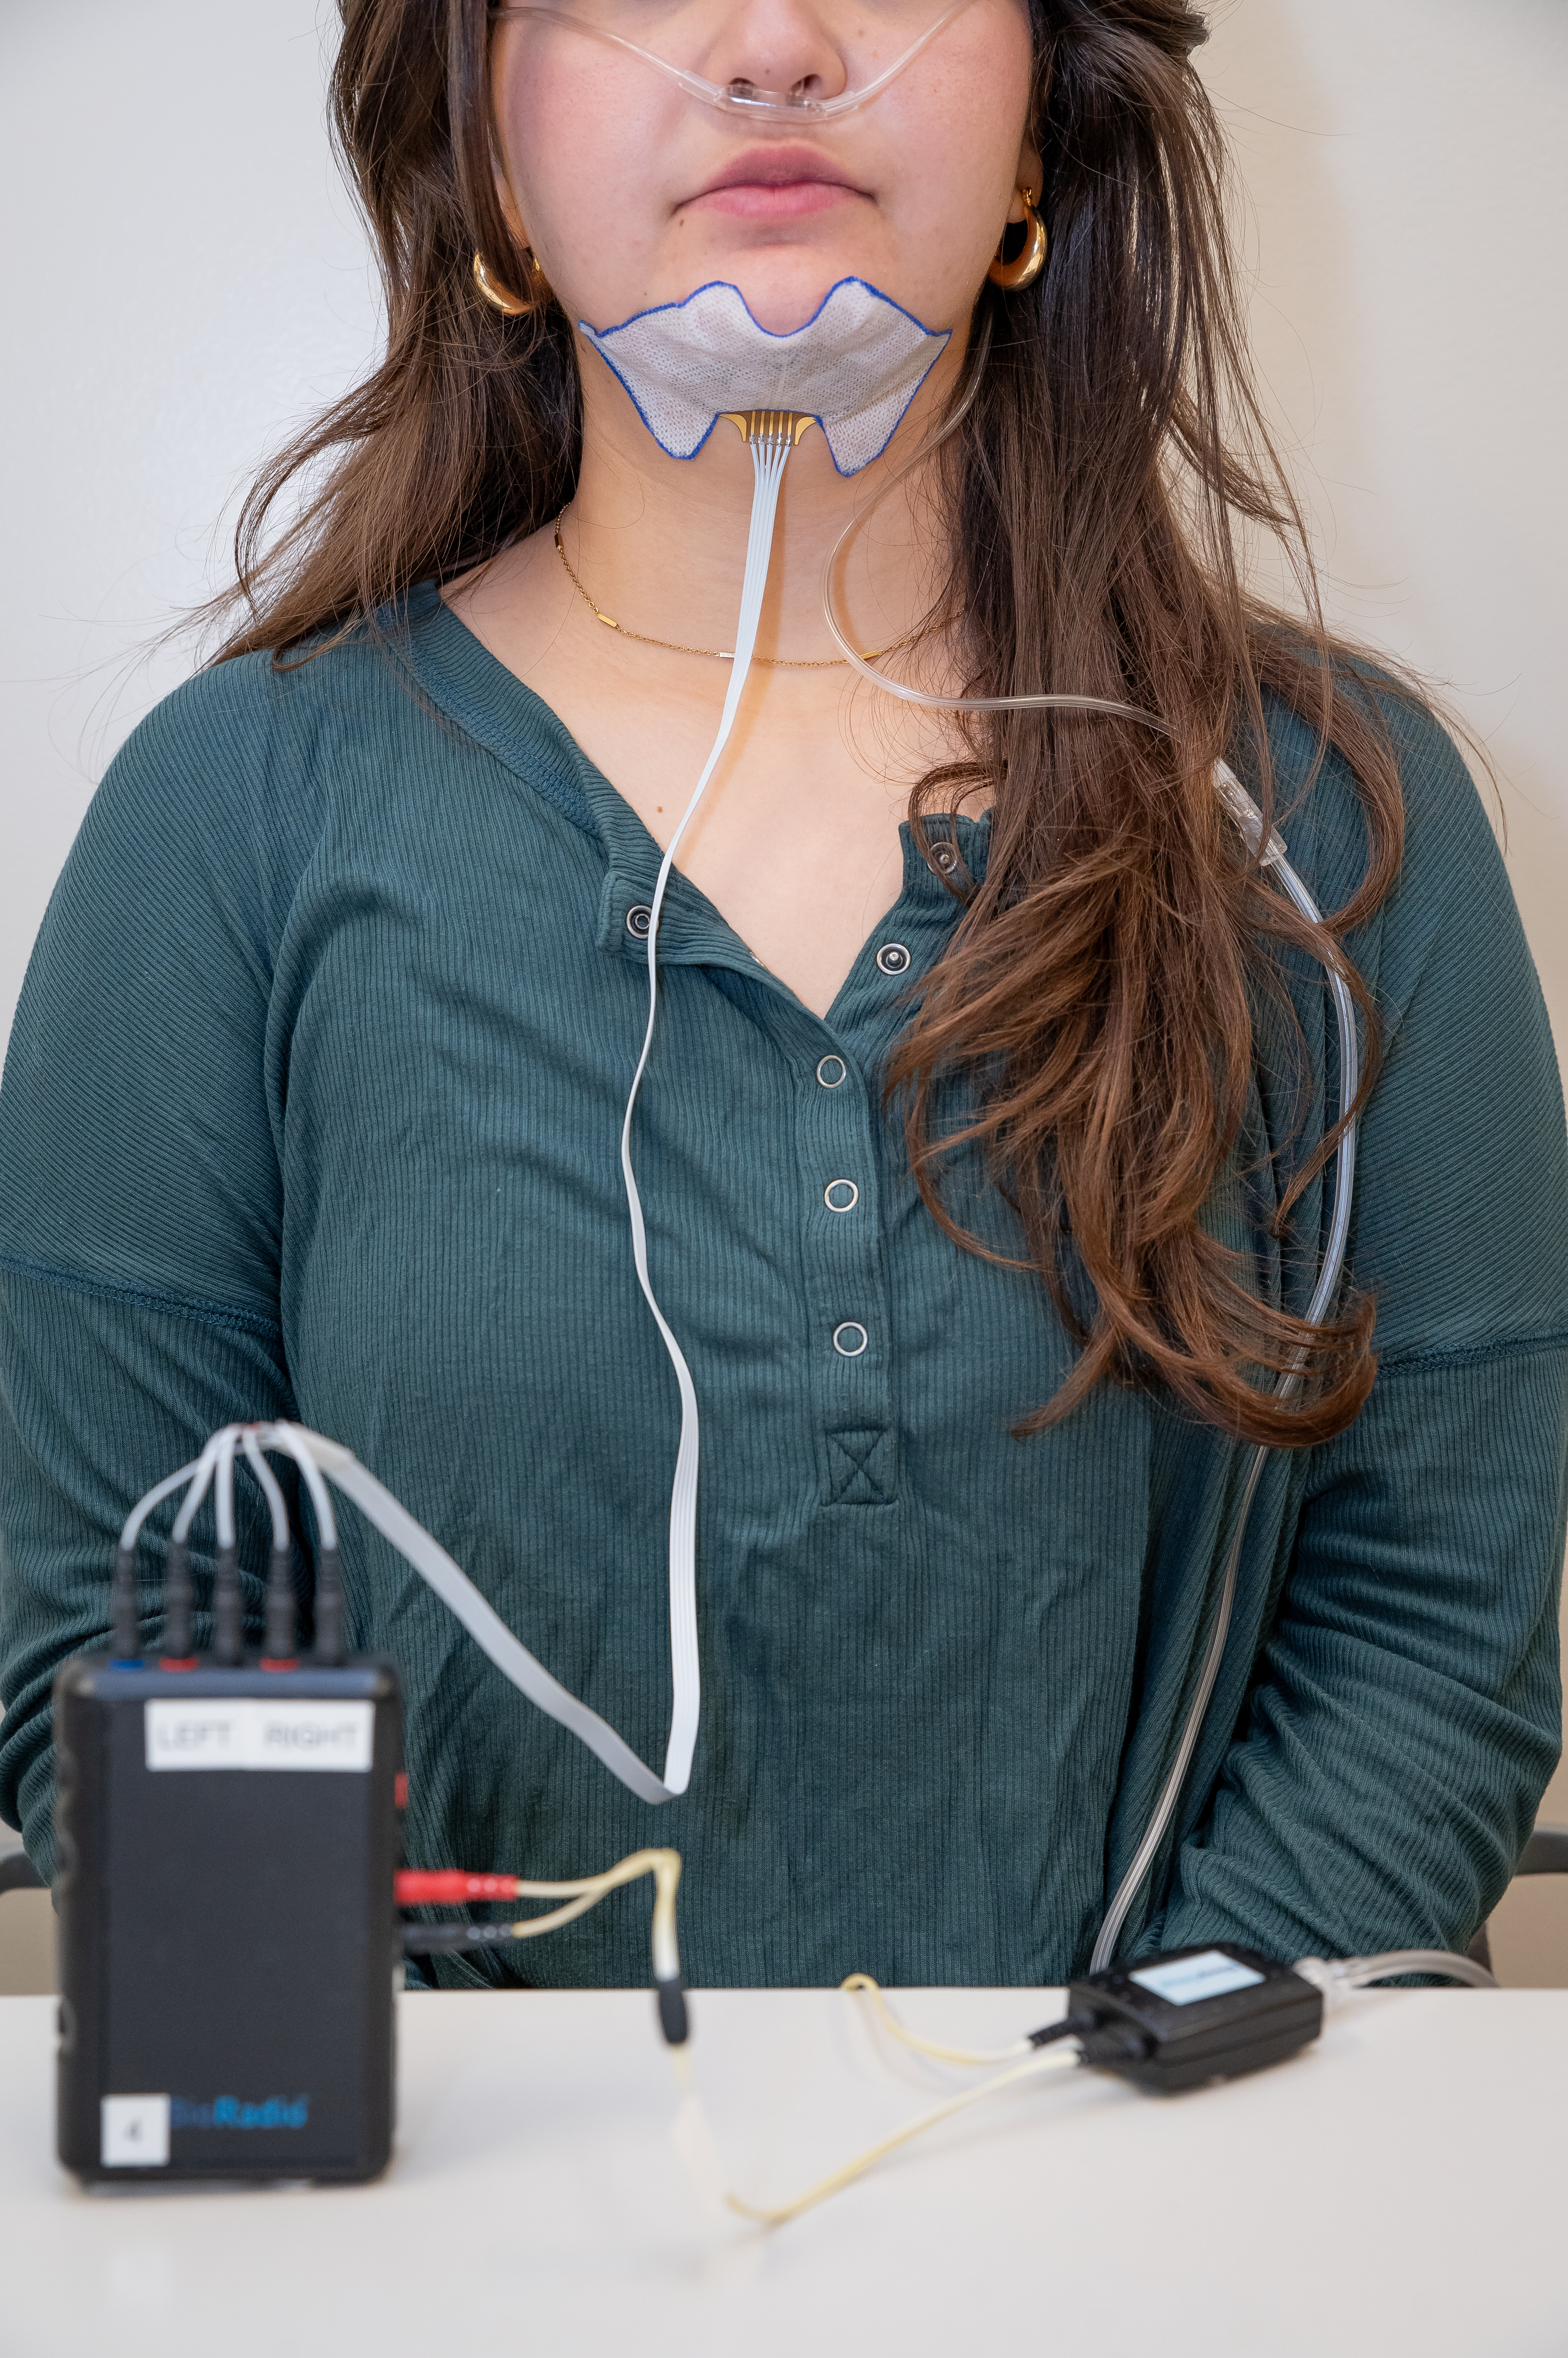
Data collection
sEMG- the sensor was placed under the chin to capture muscle contraction activity
Participants were asked to perform 2x each swallowing task while wearing the sensor
Criterion reference task (IOPI)
Randomized
5 ml thin
5 cc pudding
Effortful swallow
(hard swallow)
Mendelsohn maneuver
(swallow long)
Isometric tongue contraction
(tongue press)

Slide 8
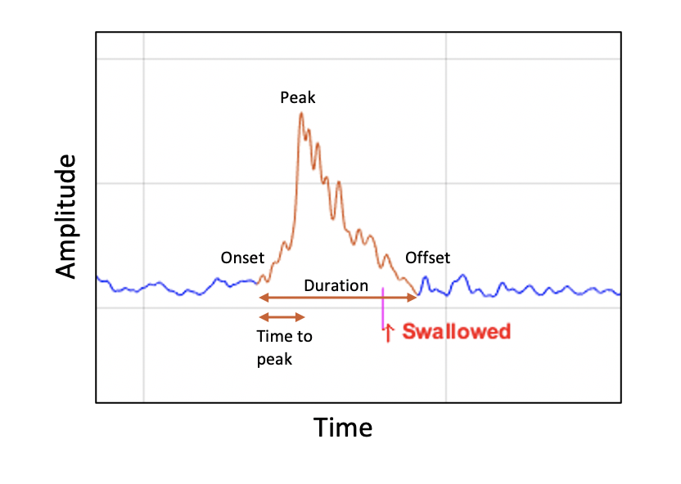
Data analyses - Variables
Independent variables
Participant group (pt w/ PD)
Exercise types (MM, ES; normal swallows)
Dependent variables
Burst duration of sEMG signal (duration/sec; ratio variable)
Normalized mean sEMG amplitude (%; ratio variable)
Time to peak sEMG amplitude (duration/sec; ratio variable)
Image from Mitchel, 2021 (thesis)
Kantarcigil et al., 2020; Smith et al., 1987; Moore, 1993; Walsh & Smith, 2013; Weber & Smith, 1987

Slide 9
Statistical ANALYSES
Aim 1
How to test aim 1- tasks
Aim 2 (need code!)
How to test aim 2 – comparison
L R test equivalence (completed w/ previous code)

